Slide 1
Performance and Power Tradeoffs,
Mobile Constraints
&
Emerging Technologies
Subject Name: Platform Based Development
Subject Code: PBDE401 | PBDV301
Lecturer Name : Freedom
Department : Information Technology

Slide 2
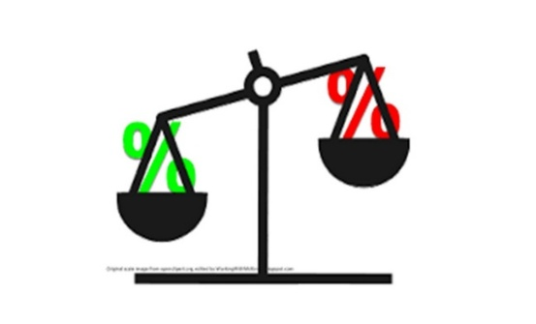
Trade-off in Mobile Devices
Mobile devices must balance several competing factors, primarily performance and battery life. High-performance tasks can drain the battery quickly, while conserving battery often means sacrificing speed or multitasking ability.
Key Tradeoffs
CPU Performance vs. Battery Drain - More powerful CPUs perform tasks faster but consume more power.
Screen Brightness and Resolution - Brighter and higher-resolution screens provide a better user experience but use more energy.
Background Processes - Allowing multiple apps to run in the background increases multitasking capabilities but also reduces battery life.

Slide 3
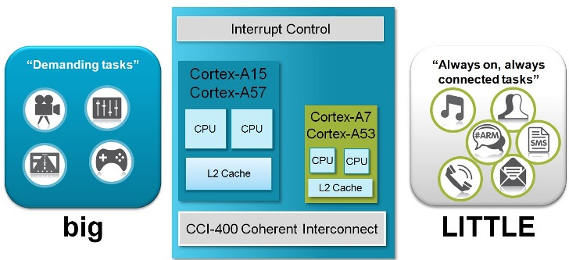
ARM big.LITTLE architecture
Modern phones

Slide 4
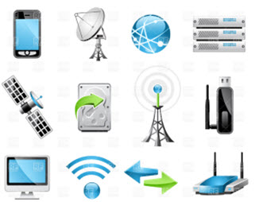
Network Behavior & Energy Cost
Wireless communication is one of the most power-hungry operations.
App that refreshes data every 5 seconds: Constant network wakeups, it battery drains quickly
Same app batching updates every 5 minutes: Fewer wakeups, has better battery life
With 5G:
Searching for signal (e.g., in elevators) very high battery drain
Developer strategy
  Cache results instead of repeatedly calling APIs
  Avoid unnecessary background syncing

Slide 5
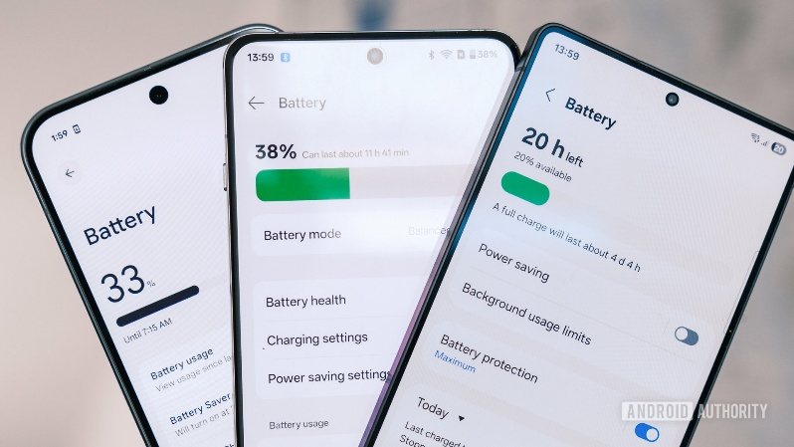
Recognizing Mobile Constraints
Mobile devices face unique limitations due to their portable nature.
Battery Constraints
  Battery is limited and drains over time
  Mobile devices have less space for large batteries and often feature less RAM than desktops, impacting the ability to perform multiple tasks simultaneously.
    GPS, Camera, Screen Brightness, Network radio
  Avoid continuous sensor usage unless necessary
  Features such as Google Pixel's Adaptive Battery optimize power usage by prioritizing battery allocation to frequently used apps (innovative solutions)

Slide 6
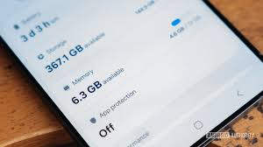
Recognizing Mobile Constraints
Memory Constraints (RAM)
  Mobile apps cannot assume large memory availability.
  Opening too many apps (OS kills background apps)
  Heavy game (May crash on low-end devices due to memory limits )
  Android Low Memory Killer
Processing Constraints
  Even though mobile CPUs are powerful, they’re still limited.
    Video editing on phone
    Real-time AI processing

Slide 7
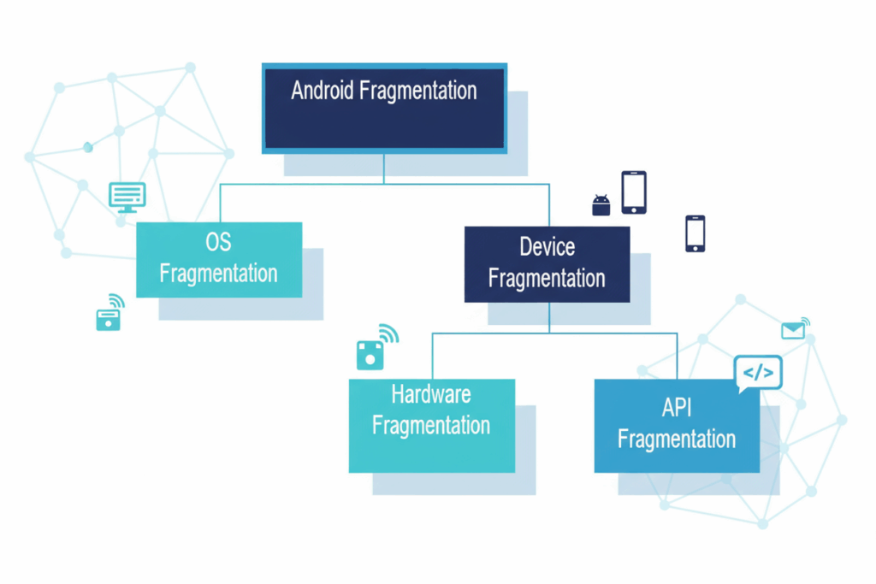
Recognizing Mobile Constraints
Network Constraints
  Mobile networks are unreliable.
UI & Interaction Constraints
  Small screen & Touch input only
Security Constraints
  Mobile devices are often used on
  public networks
Device Fragmentation
  Thousands of device variation
  Different screen sizes
  Different CPU/GPU capabilities
  Different OS versions

Slide 8
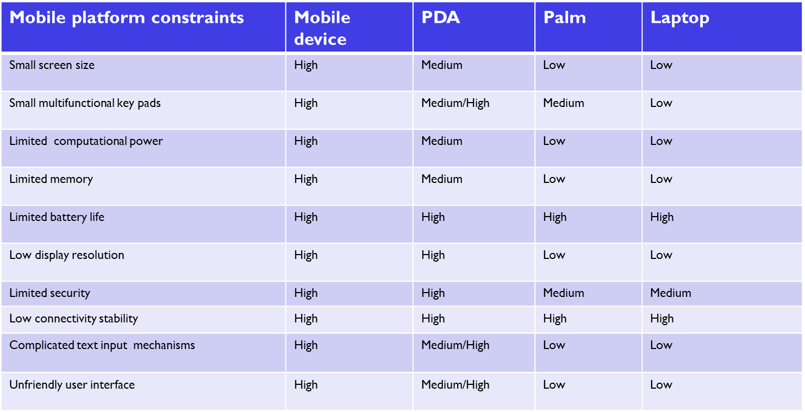
Recognizing Mobile Constraints

Slide 9
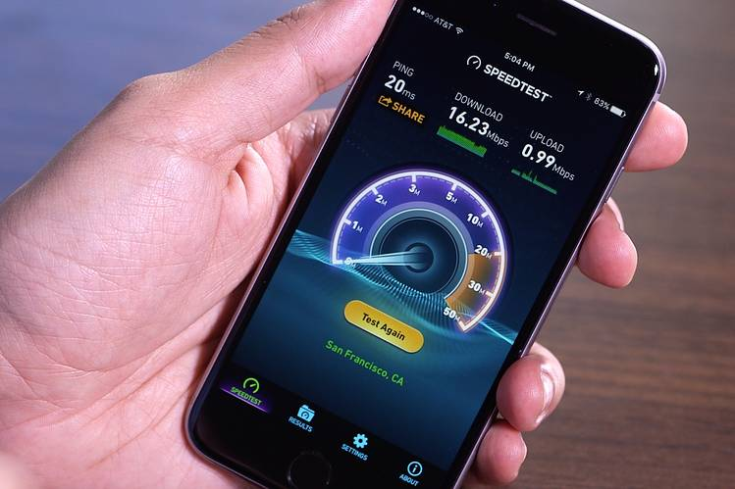
Strategies for Improving Mobile App Performance
Utilizing efficient algorithms and managing app resources wisely can reduce energy consumption (Efficient Coding and Resource Management).
Apps can minimize battery drain by reducing data update frequency and using low-power APIs (Data Fetching Optimization) .
Leveraging device GPUs for intensive graphics tasks and APIs designed for low power consumption can help maintain performance without excessive battery usage.

Slide 10
Impact of Emerging Technologies on Mobile Performance
Artificial Intelligence (AI) -AI optimizes device performance through adaptive learning of user habits and managing device functionalities accordingly.
5G Technology - The introduction of 5G enhances data speeds and reliability, reducing latency and the power used in data processing.
Augmented Reality (AR) - Despite its resource-intensive nature, advancements in mobile GPUs and optimized AR frameworks enable efficient AR applications.
Edge Computing and Predictive Maintenance- Processing data closer to the user and using AI for predictive maintenance can further enhance performance and extend device life.

Slide 11
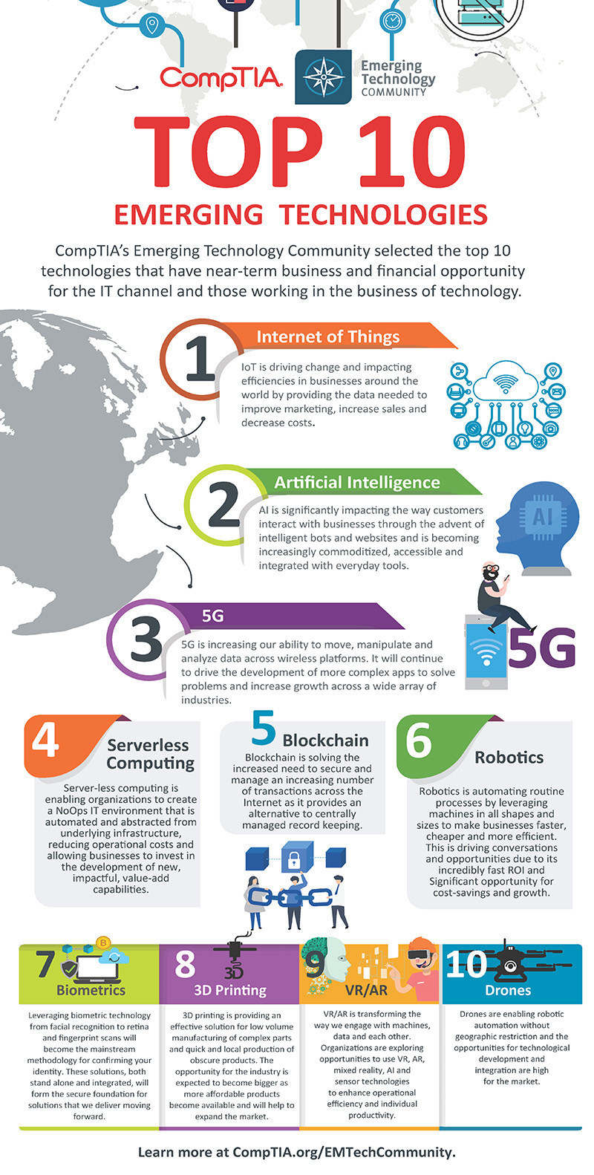

Slide 12

Conclusion
Final Key Insights
Mobile systems are constraint-driven systems:
  Battery is the biggest limitation
Every feature has a cost:
  Better UX vs more power usage
  More efficiency vs less responsiveness
Good mobile apps:
  Adapt to device conditions
  Minimize unnecessary work
  Handle unreliable environments
Emerging technologies:
  Increase capability
  But also increase complexity in
  managing performance and power

Slide 13
Question
A fitness app continuously tracks steps while the user is casually walking and occasionally opens messages. The system aims to maximize battery life without noticeable lag.
Which strategy is MOST appropriate based on ARM big.LITTLE architecture?
  A. Run all processes on big cores to ensure responsiveness
  B. Run tracking on little cores and temporarily switch to big cores when opening messages
  C. Use only little cores even when opening messages to conserve power
  D. Alternate randomly between cores to balance heat

Slide 14
Question
A social media app refreshes the feed every 10 seconds in the background, causing significant battery drain.
What is the BEST improvement?
  A. Increase refresh frequency to reduce latency
  B. Switch to 5G for faster updates
  C. Batch updates and refresh less frequently or on user interaction
  D. Keep frequent polling but reduce image quality

Slide 15
Question
An image-heavy app crashes frequently on low-end devices but works fine on high-end phones.
What is the MOST effective solution?
  A. Increase image resolution for clarity
  B. Load all images at app startup
  C. Use compressed images and lazy loading
  D. Force app to use more RAM

Slide 16
Question
A smart home app processes camera footage to detect motion.
Which approach BEST reduces latency and power usage?
  Send all video data to the cloud continuously
  B. Process video locally using Edge Computing
  C. Store video and process it later in batches
  D. Disable real-time processing entirely

Slide 17
Question
An email app checks for new messages every minute, draining battery unnecessarily.
What is the BEST solution using Android WorkManager?
  A. Run checks continuously in the foreground
  B. Schedule periodic checks with constraints (e.g., Wi-Fi or charging)
  C. Disable background checks entirely
  D. Increase checking frequency but reduce data size

